Slide 1

MedicAI: An intelligent Patient-Doctor matching system
Enzo Benoit-Jeannin
Wassim Jabbour
Eddy Hage

Slide 2
Some application functionality
Chat with Medo to get an appointment
Patient
Get referred to other doctors
Perspectives
Maintain and view your schedule
Doctor
View top doctors

Slide 3
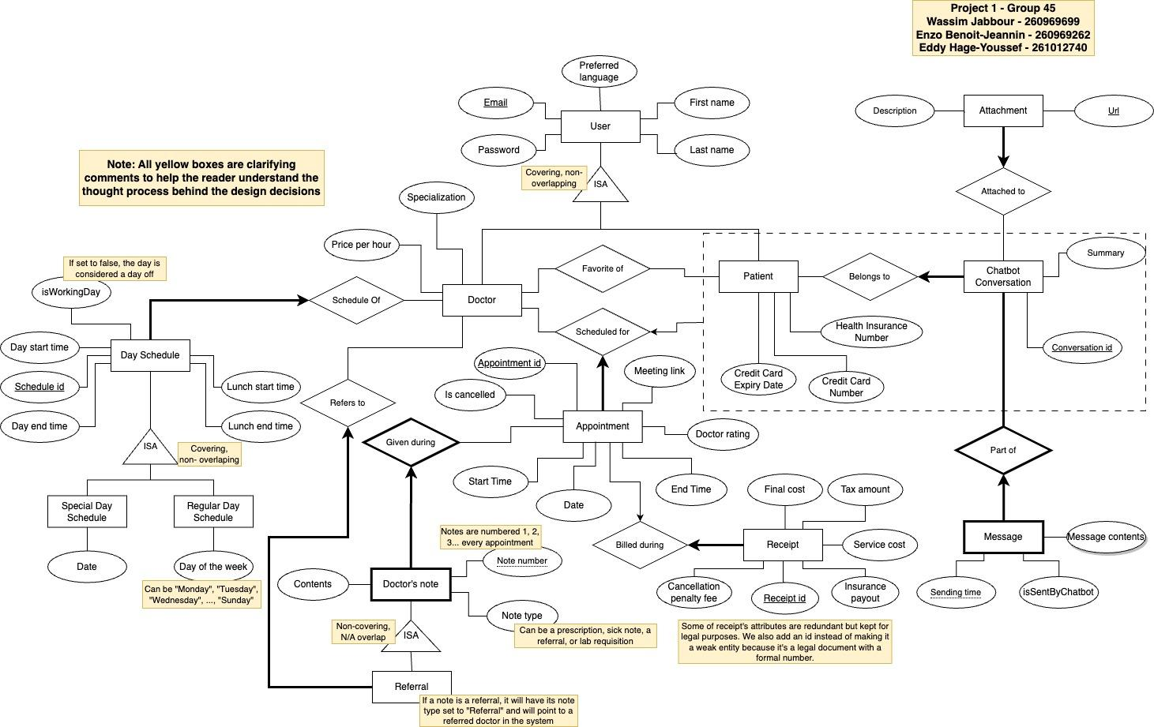

Slide 4




Technologies used

